Slide 1

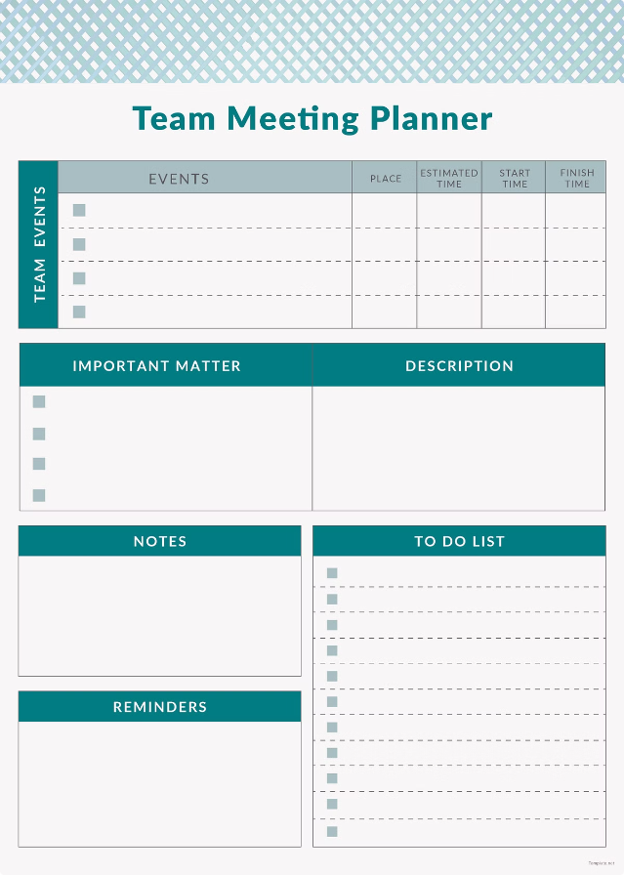
Event Management System
An Event Management System (EMS) is a comprehensive solution designed to help:
Organize events
Manage events
Execute events
These systems typically encompass a range of functionalities.
2210030380 - C.Chinmayee
2210030338 –P .Trisha
2210030388 - N.Tulasi
2210030369 - T.Meghana
2210030372 - E.Lalitha

Slide 2


Problem Statement
1
Coordinating Multiple Stakeholders
Efficiently managing communication and tasks between organizers, vendors, and attendees can be a complex challenge.
2
Streamlining Event Logistics
Ensuring the smooth flow of event activities, from setup to takedown, requires a comprehensive system.
3
Maximizing Event Success
Collecting and analyzing data to measure the performance and impact of an event is crucial for future improvements.

Slide 3

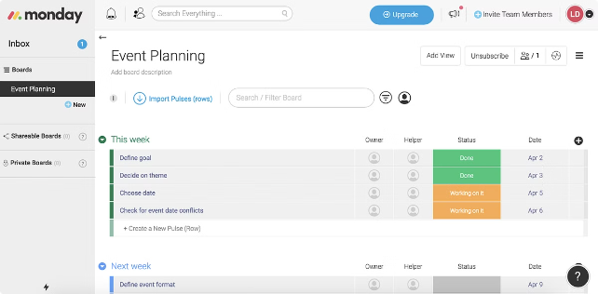
Existing Projects
1
Eventbrite
Leading event management platform for ticketing, promotion, and analytics.
2
Cvent
Comprehensive solution for event planning, registration, and venue sourcing.
3
Bizzabo
AI-powered event management platform with features for both in-person and virtual events.

Slide 4
Key Features of the System
Event Planning
Attendee Registration
Data Analytics
Centralized platform for managing event details, such as venue, catering, and speaker logistics.
Streamlined registration process with real-time updates and customizable ticket options.
Comprehensive reporting and analytics to measure event success and optimize future planning.

Slide 5
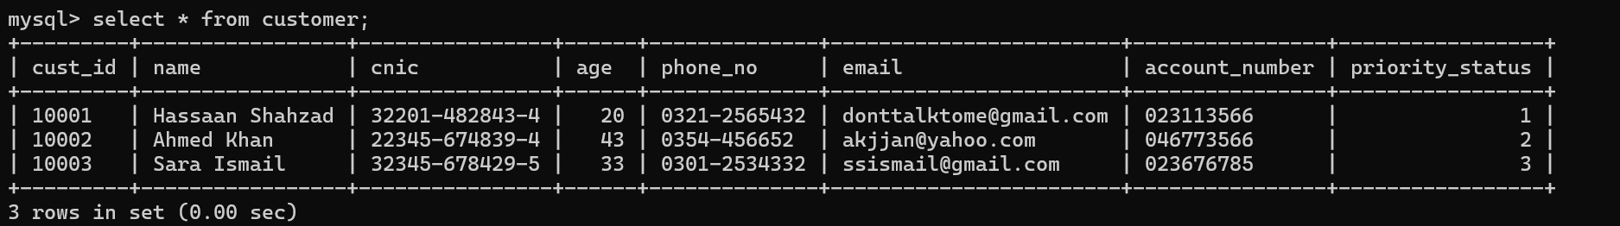
SQL Tables

Slide 6
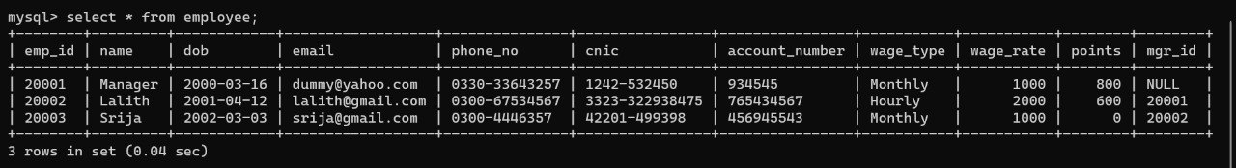
SQL Tables

Slide 7
SQL Tables

Slide 8
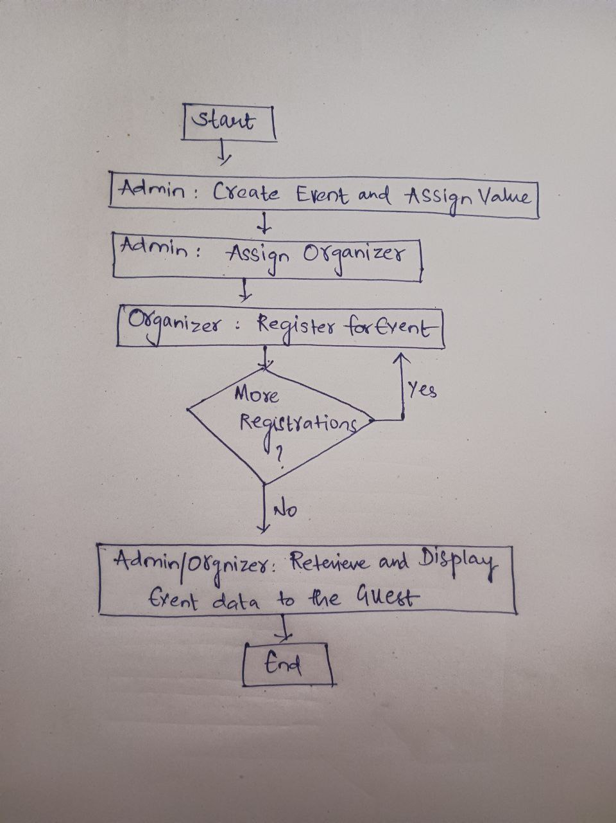
Workflow Diagram

Slide 9
THANK YOU

